Slide 1
MST Knit For Kid’s

Slide 2
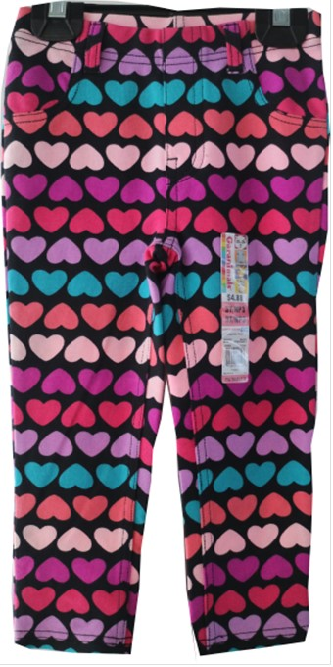
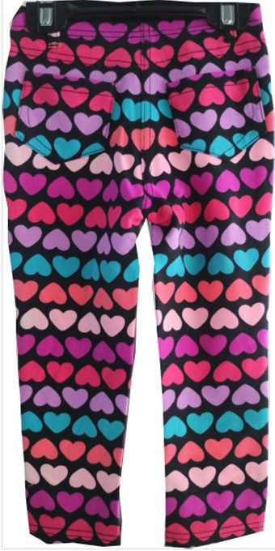
Fabrication : 71% CTTN / 25% POLY / 4% SPDX - PRINT KNIT DENIM – 210 GSM
Color : S8188B Multi Hearts
FOB: $5.05/PCS
Notes:
Fabrication -

Slide 3
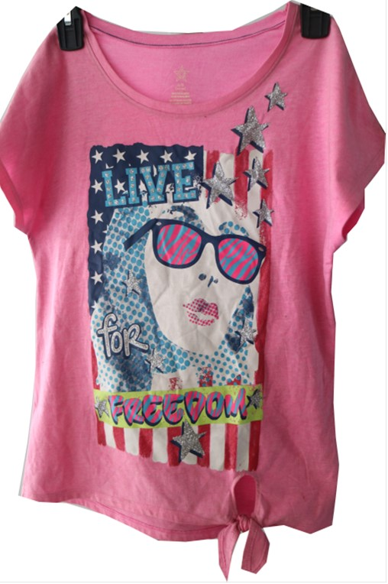
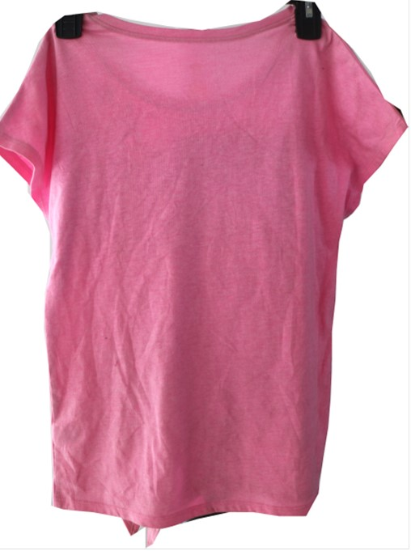
Fabrn : 100% COTTON S/J PRINT KNIT – 165 GSM
Coloicatior : S9531
FOB: $3.20/PCS

Slide 4
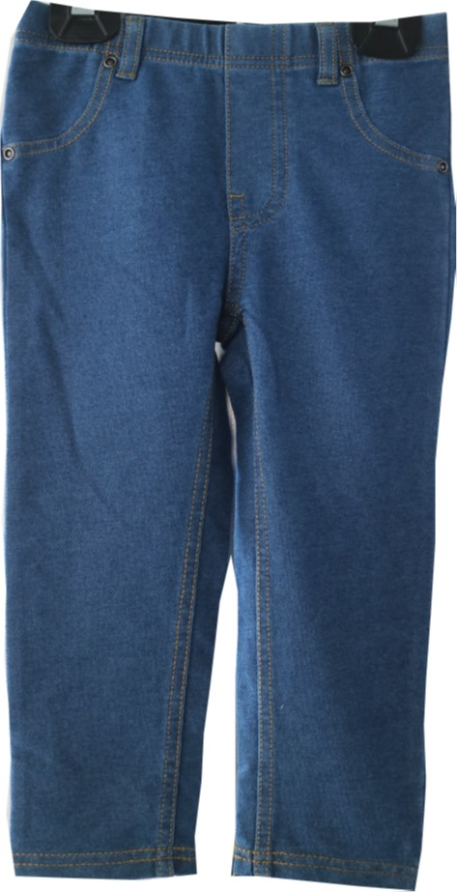
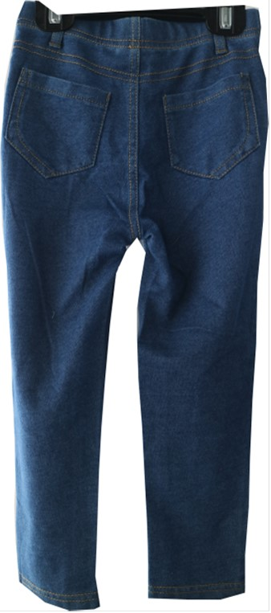
Fabrication : 77% COTTON 19% POLYESTER 4% SPANDEX TWILL KNIT DENIM – 210 GSM
Color – Light Wash ( LT DENIM)
FOB: $4.40/PCS

Slide 5
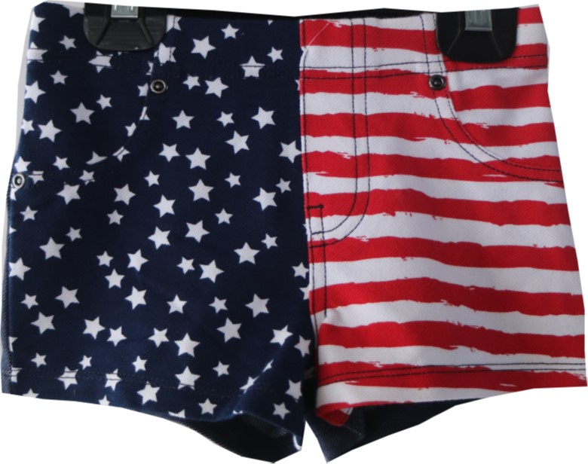
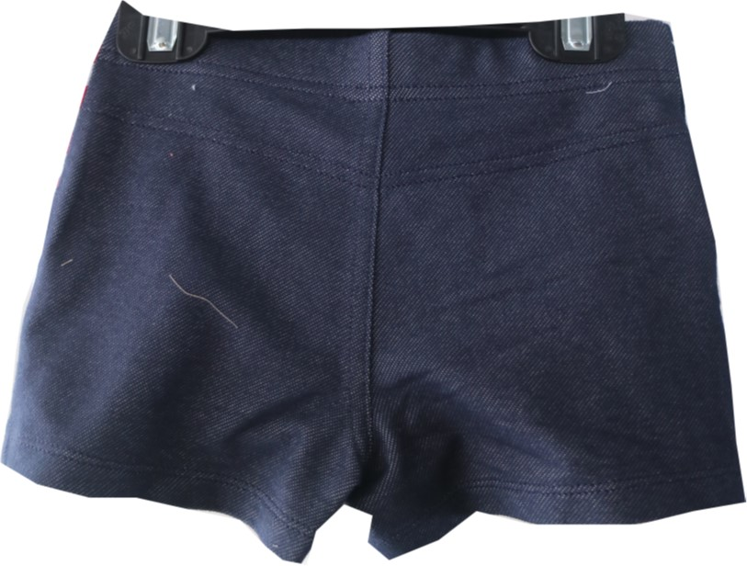
Fabrication : 71% CTTN / 25% POLY / 4% SPDX PRINT KNIT DENIM – 210 GSM
Color : Flag Print
FOB: $3.90/PCS

Slide 6
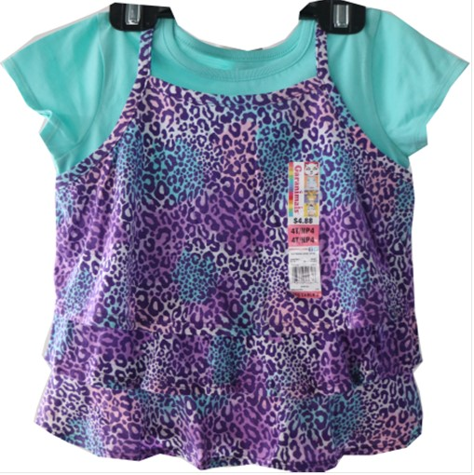
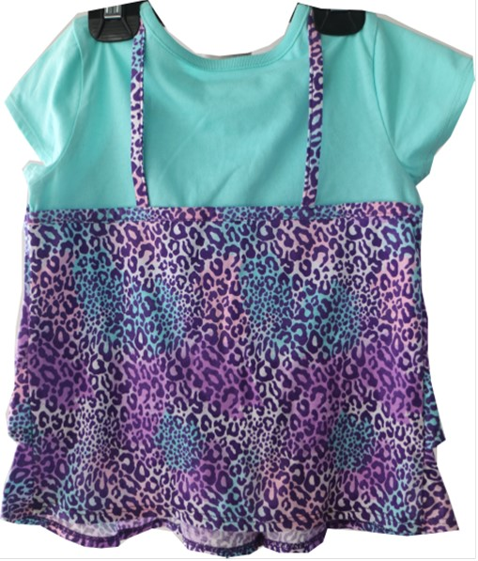
Fabrication : Body : 60% Polyester 40% Jersey -150 Gsm. Color : Mint Frosting
FOB: $3.60/PCS

Slide 7
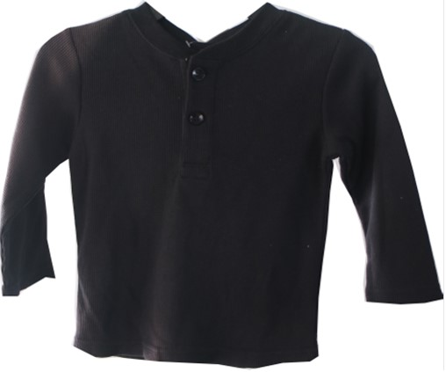
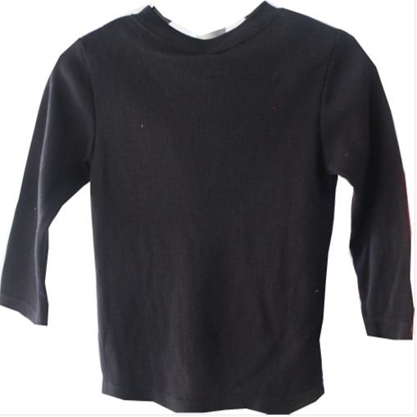
Fabrication : Body : 60% Polyester 40% Cotton Thermal -220 Gsm, Neck Binding : 60% Polyester 40% 1x1 rib -180 Gsm. Color : Black Soot
FOB: $3.00/PCS

Slide 8
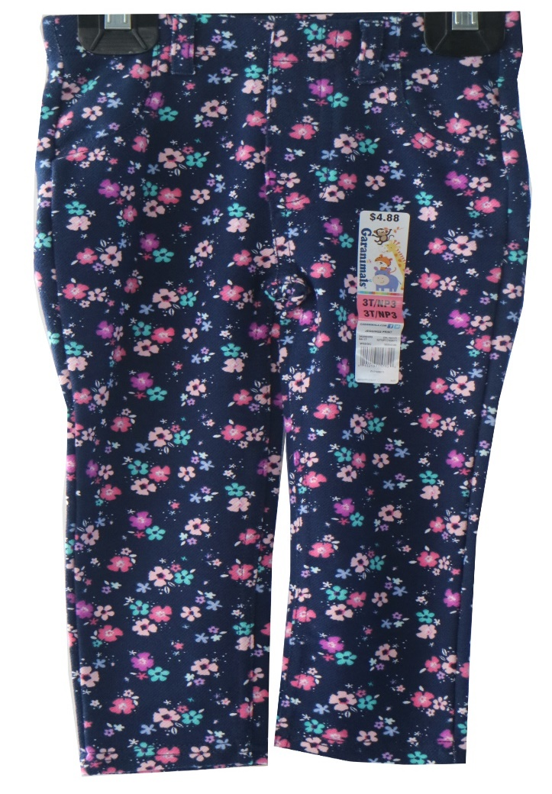
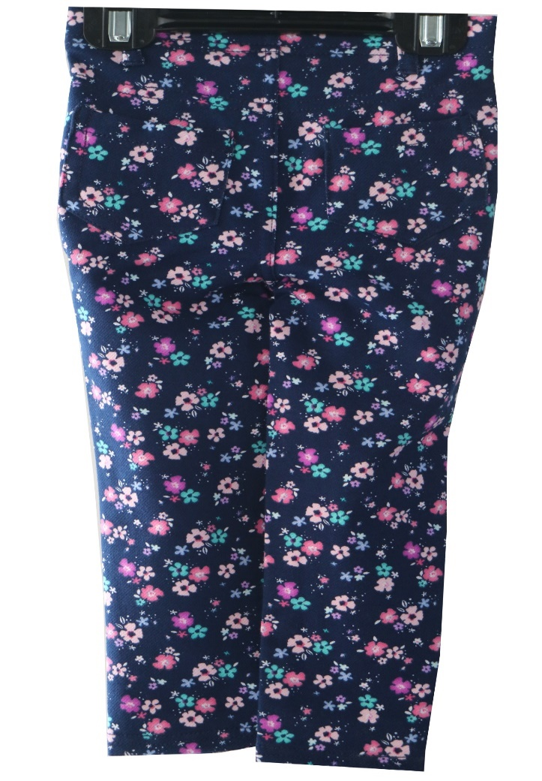
Fabrication : 71% CTTN / 25% POLY / 4% SPDX - PRINT KNIT DENIM – 210 GSM
Color : S8694 HOLIDAY NAVY DITSY FLORAL
FOB: $4.70/PCS

Slide 9
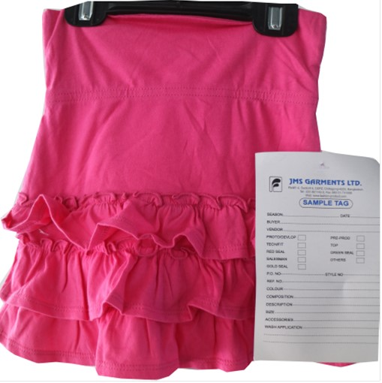
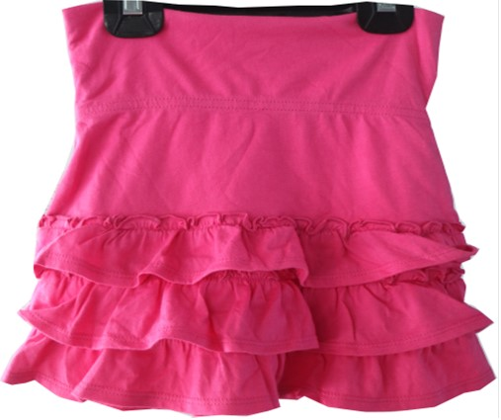
Fabrication : Body : 60% Polyester 40% Jersey -150 Gsm. Color : DK PINK
FOB: $3.30/PCS

Slide 10
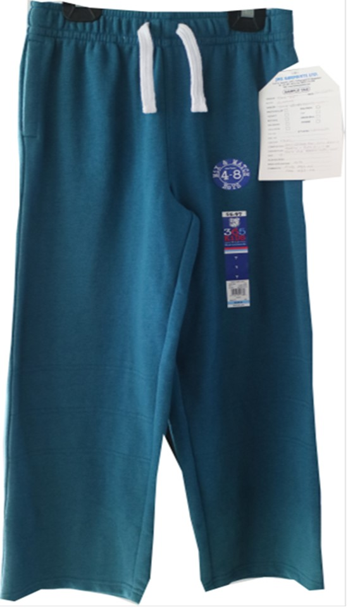
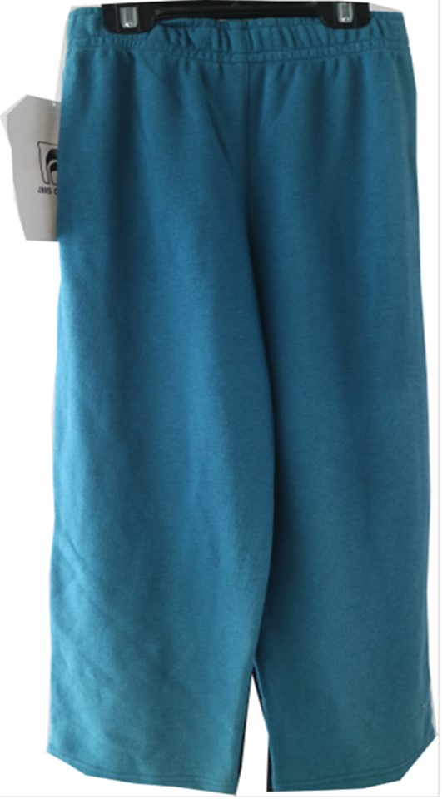
Fabrication : Body : 60% Polyester 40% Cotton French Terry -240 Gsm, Pocketing : 60% Polyester 40% Jersey -150 Gsm. Color : Teal
FOB: $2.90/PCS

Slide 11
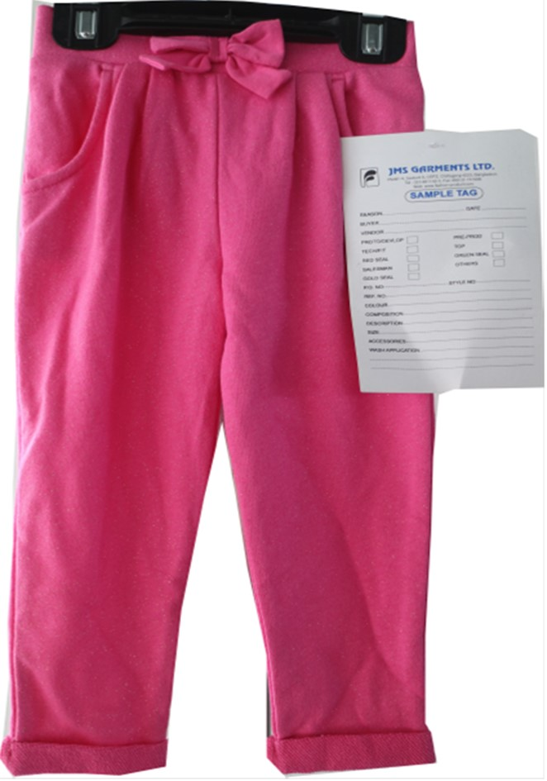
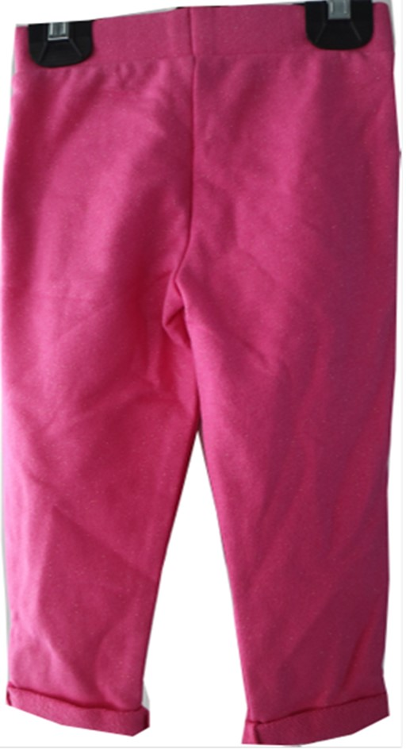
Fabrication : Body : 60% Polyester 40% Cotton French Terry -240 Gsm, Pocketing : 60% Polyester 40% Jersey -150 Gsm. Color : BUBBLEGUM PINK WI/ GOLD GLITTER

Slide 12
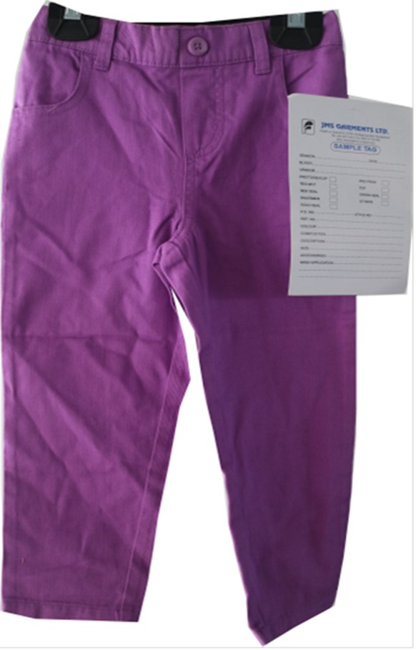
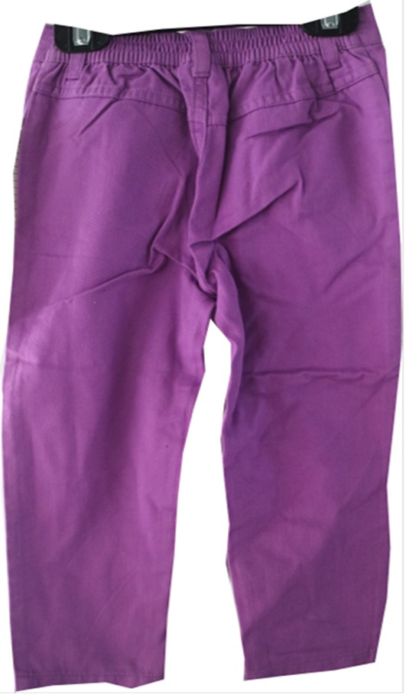
Fabrication : 100% cotton Twill – 5.6OZ Before Wash ( Color - lilac Bud)

Slide 13
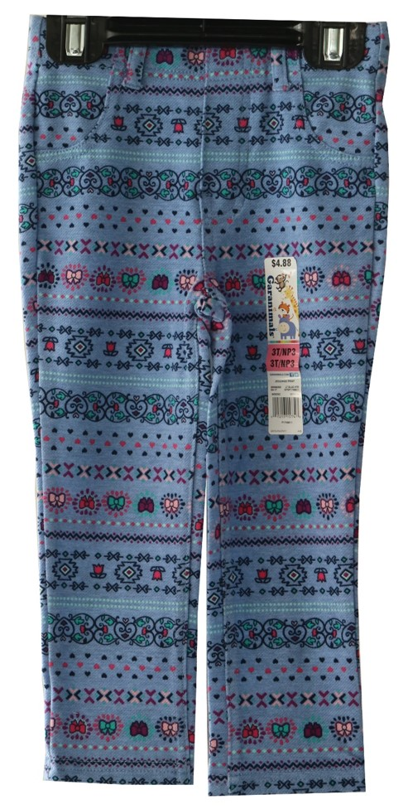
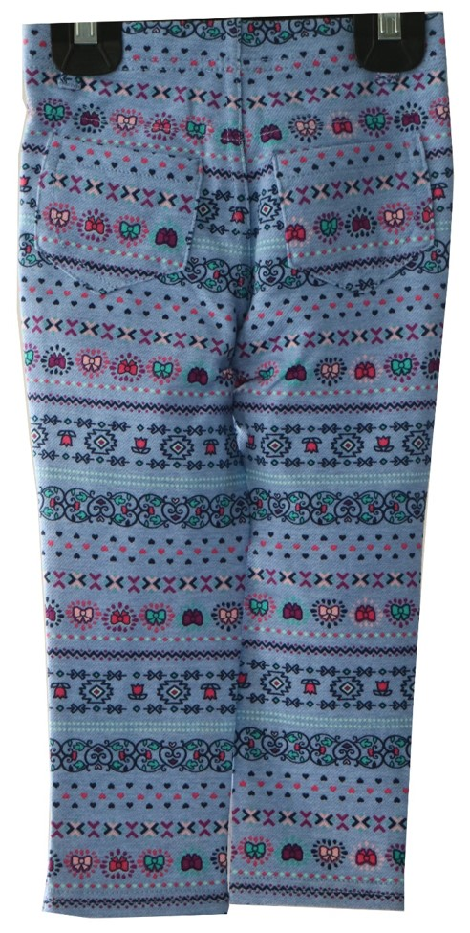
Fabrication : 71% CTTN / 25% POLY / 4% SPDX - PRINT KNIT DENIM – 210 GSM
Color : S8690 TRIBAL STRIPE W/ BOW

Slide 14
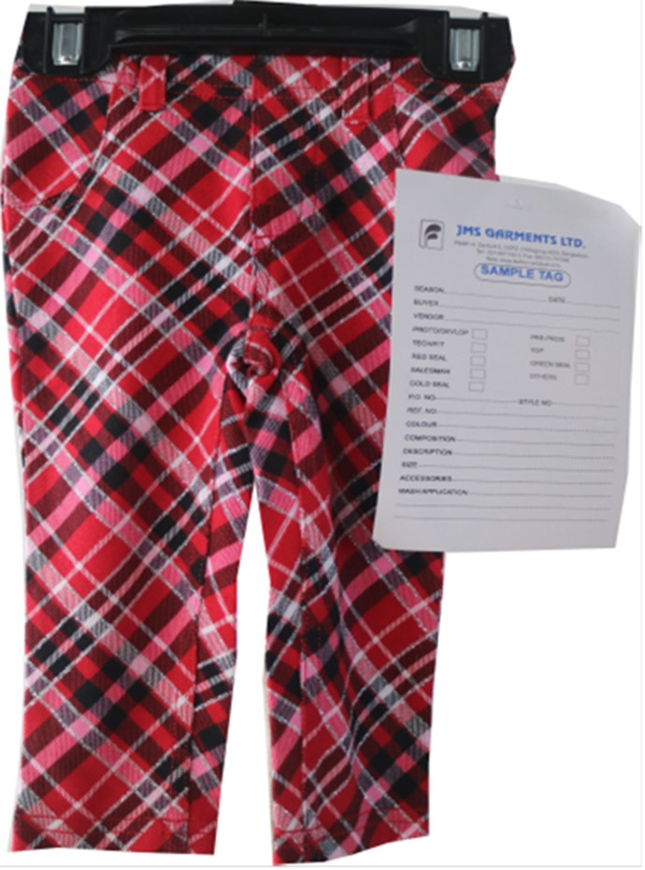
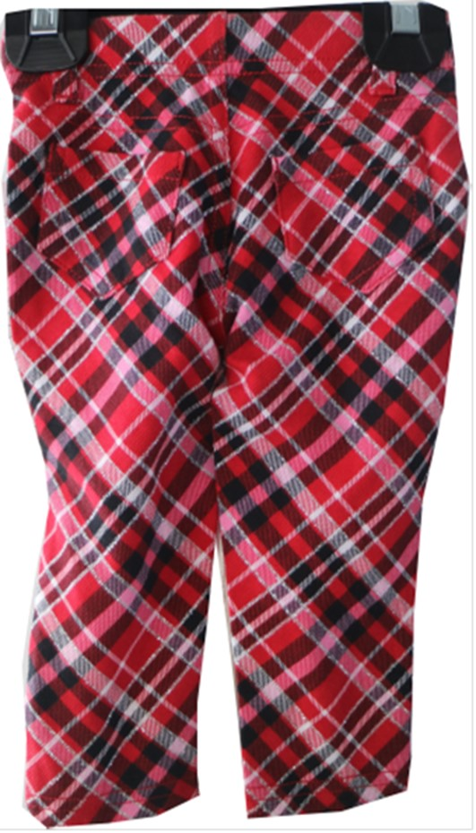
Fabrication : 71% CTTN / 25% POLY / 4% SPDX - PRINT KNIT DENIM – 210 GSM
Color : Red Plaid

Slide 15
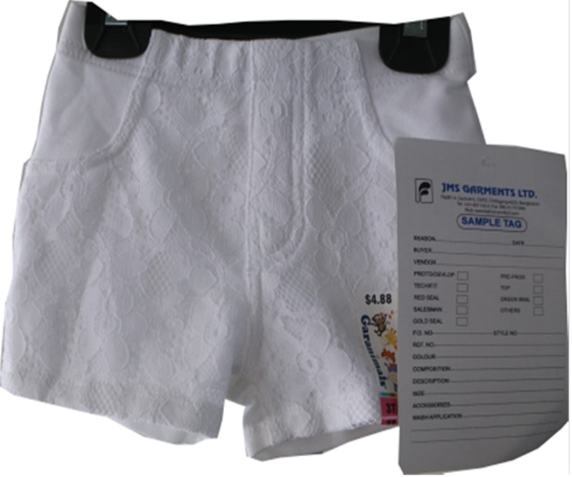
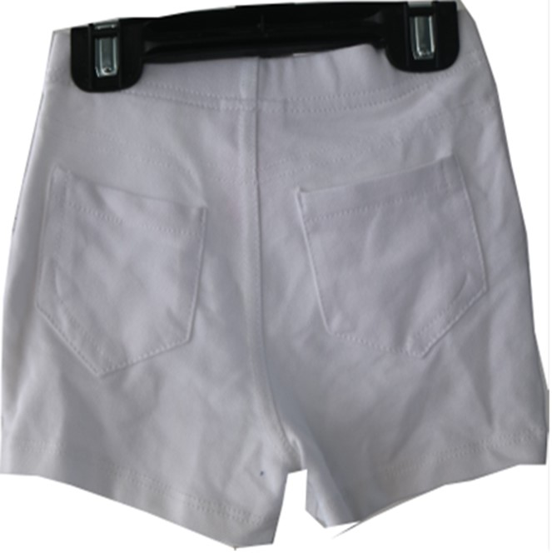
Fabrication : 69% CTTN / 27% POLY / 4% SPANDEX KNIT DENIM – 210 GSM , COLOR – ARCTIC WHITE

Slide 16
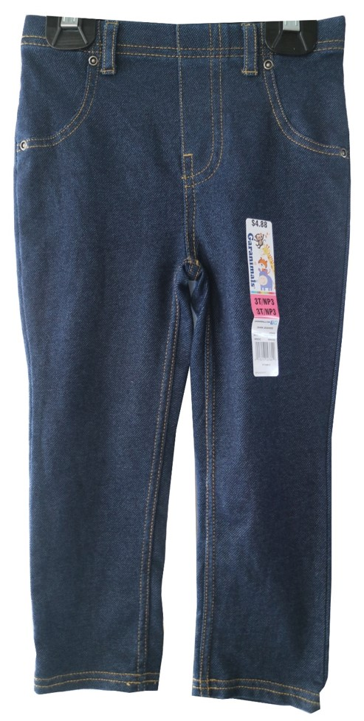
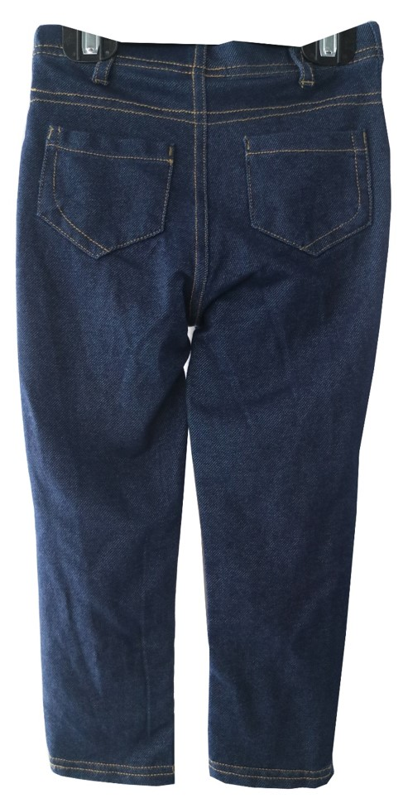
Fabrication : Fabrication : 69% CTTN / 27% POLY / 4% SPANDEX KNIT DENIM – 210 GSM , COLOR – INDIGO DENIM

Slide 17
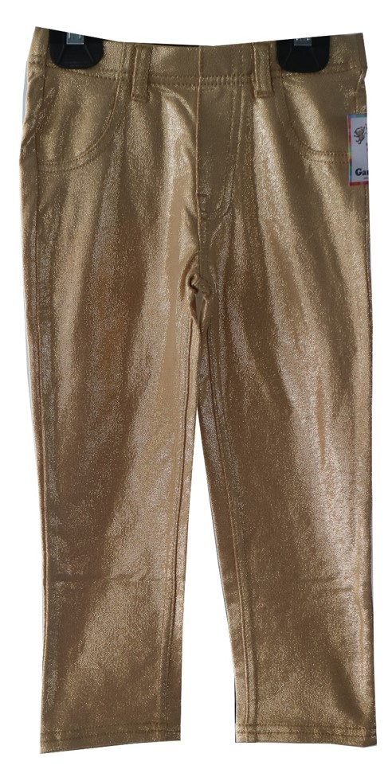
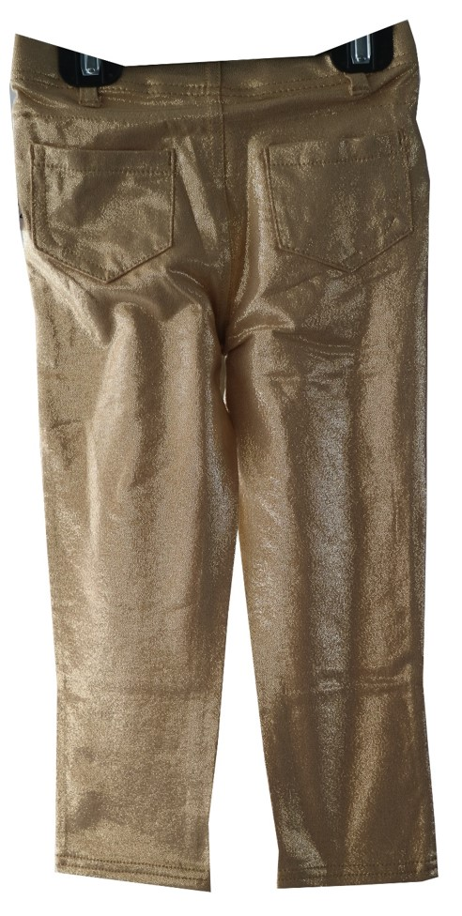
Fabrication : 57% CTTN / 38% POLY / 5% SPDX JERSEY – 180 GSM

Slide 18
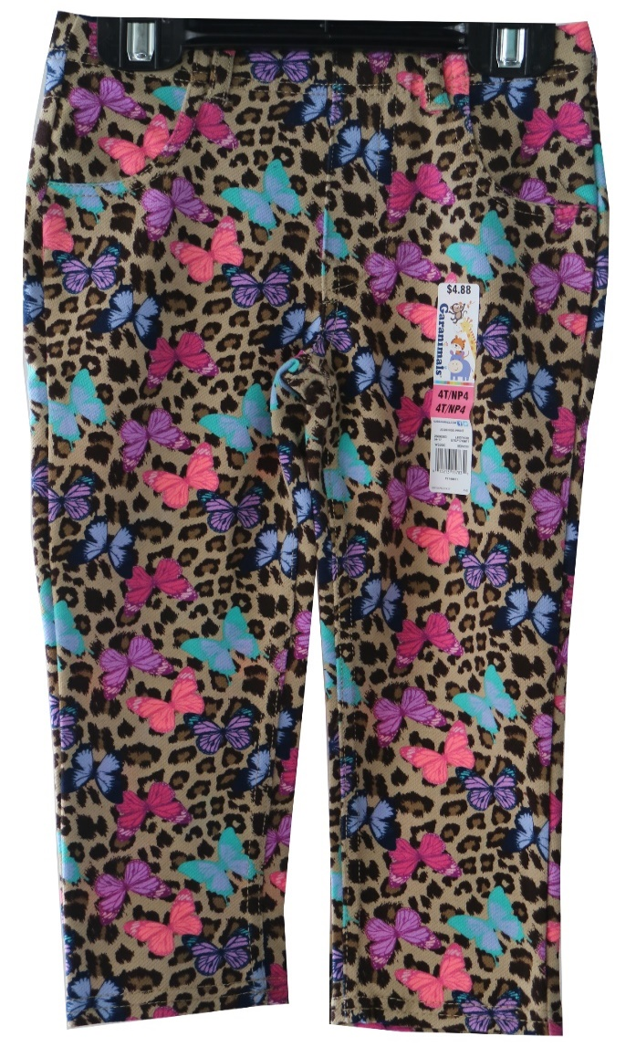
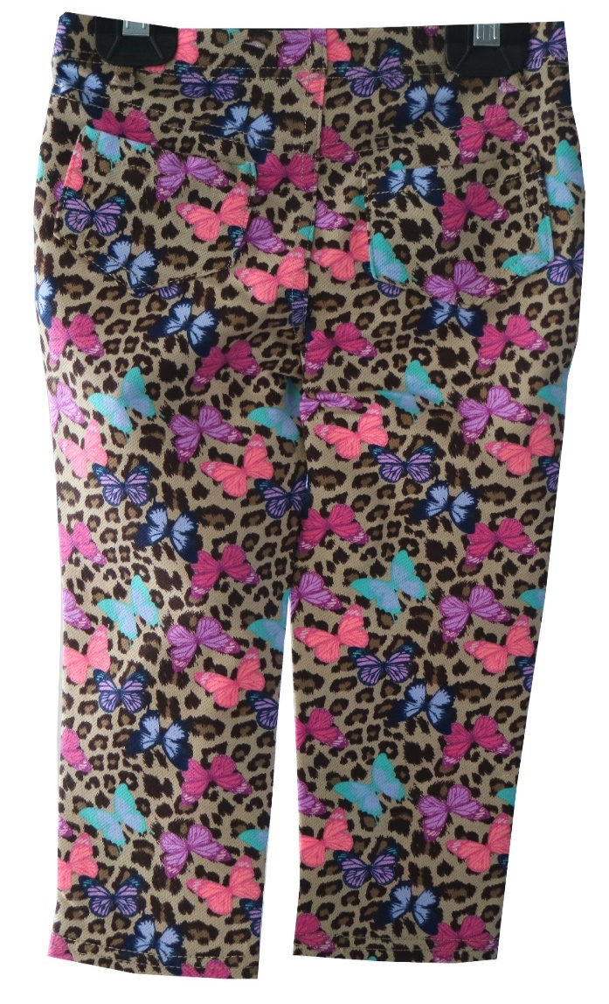
Fabrication : 71% CTTN / 25% POLY / 4% SPDX - PRINT KNIT DENIM – 210 GSM
Color : LEOPARD

Slide 19
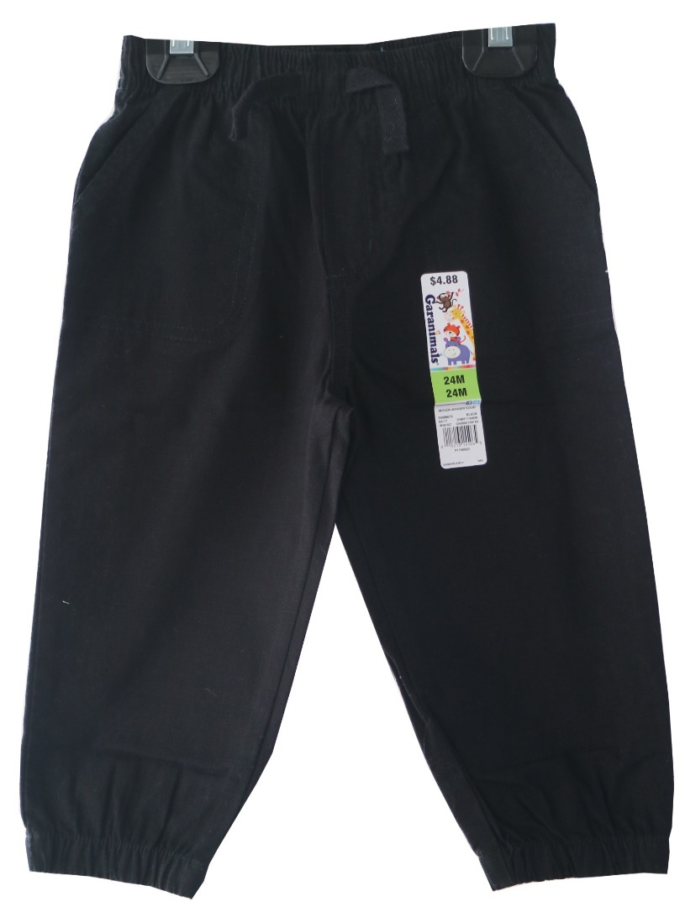
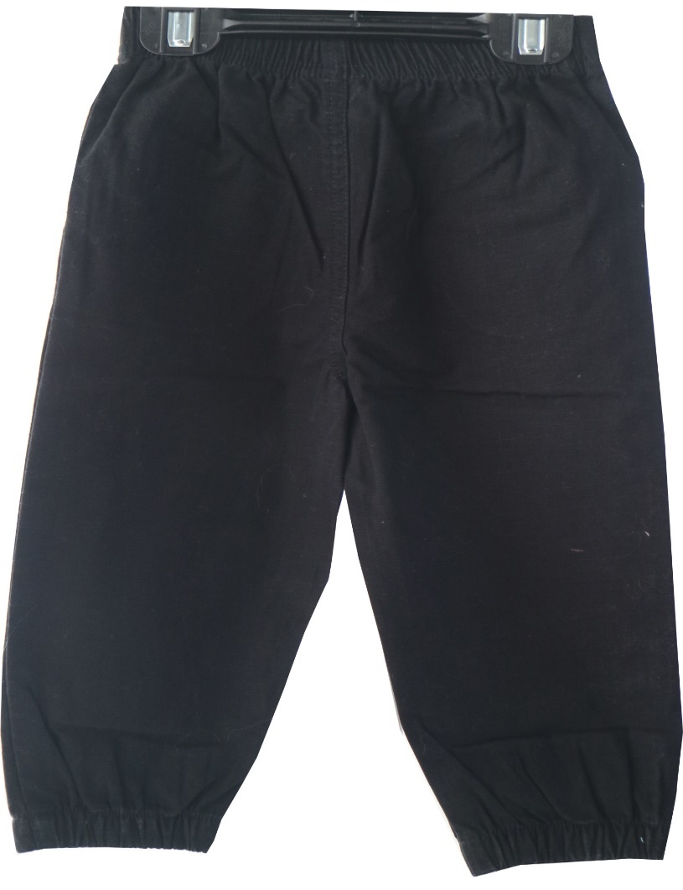
Fabrication – 100% cotton ripstop twill - 5.6 OZ (Before Wash), Color – Black Soot

Slide 20
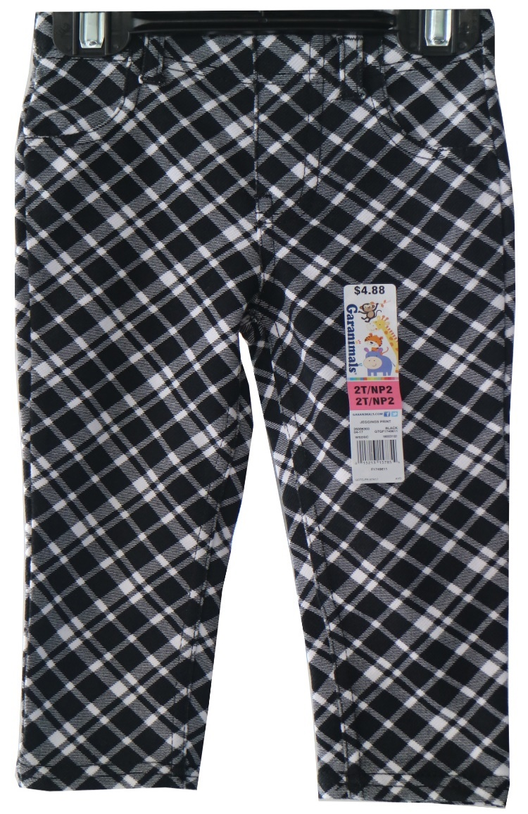
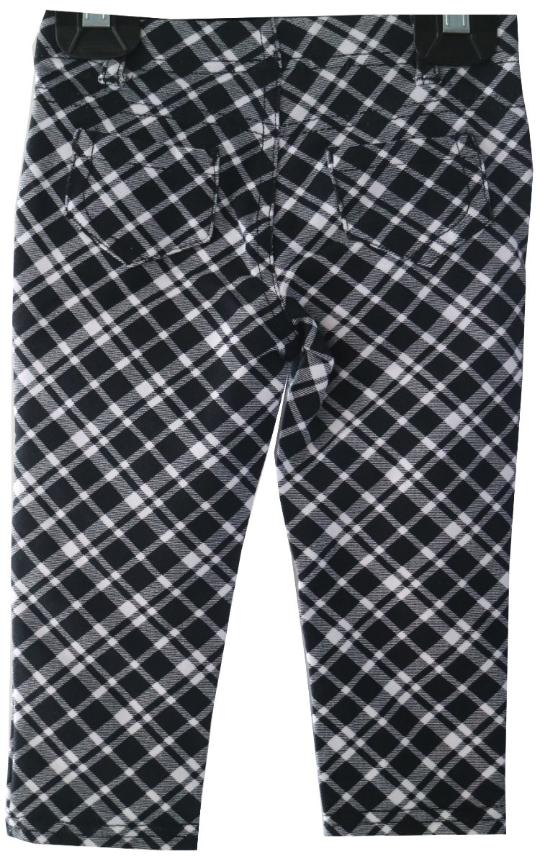
Fabrication : 71% CTTN / 25% POLY / 4% SPDX - PRINT KNIT DENIM – 210 GSM
Color : Black & White Plaid

Slide 21
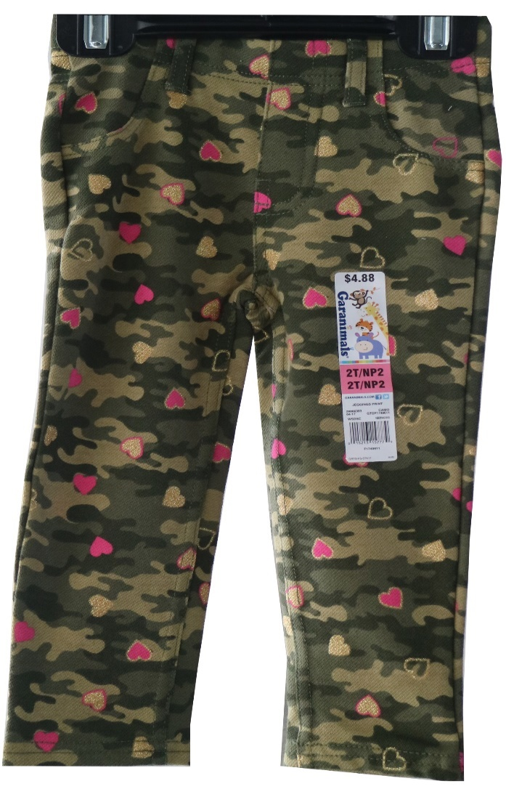
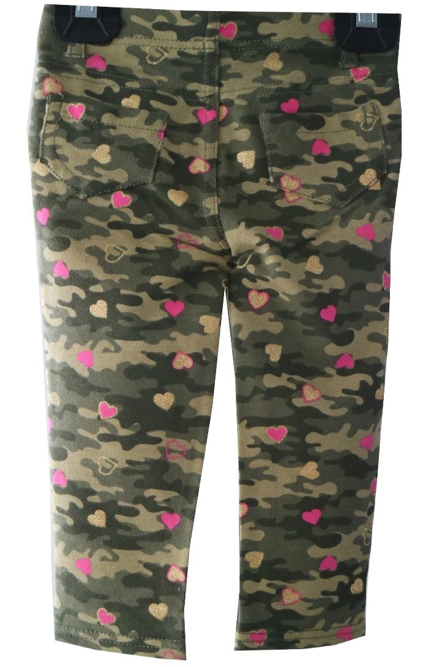
Fabrication : 71% CTTN / 25% POLY / 4% SPDX - PRINT KNIT DENIM – 210 GSM
Color : LEOPARD

Slide 22
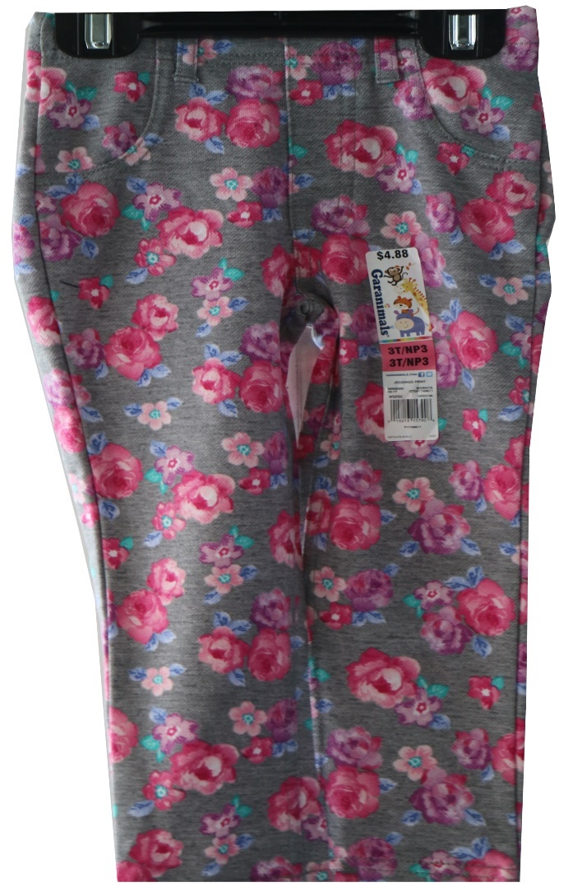
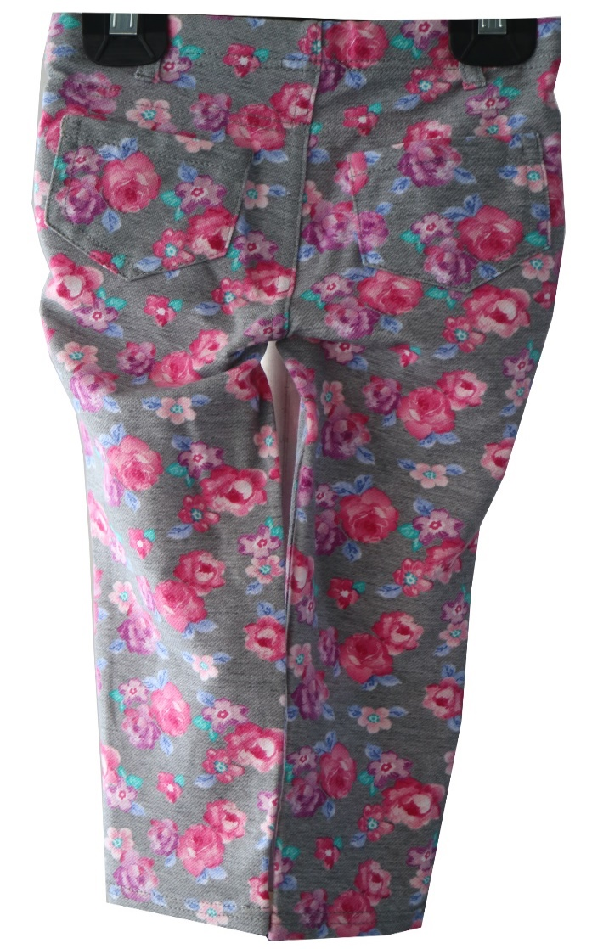
Fabrication : 71% CTTN / 25% POLY / 4% SPDX - PRINT KNIT DENIM – 210 GSM
Color : Med Grey Heather Floral Print

Slide 23
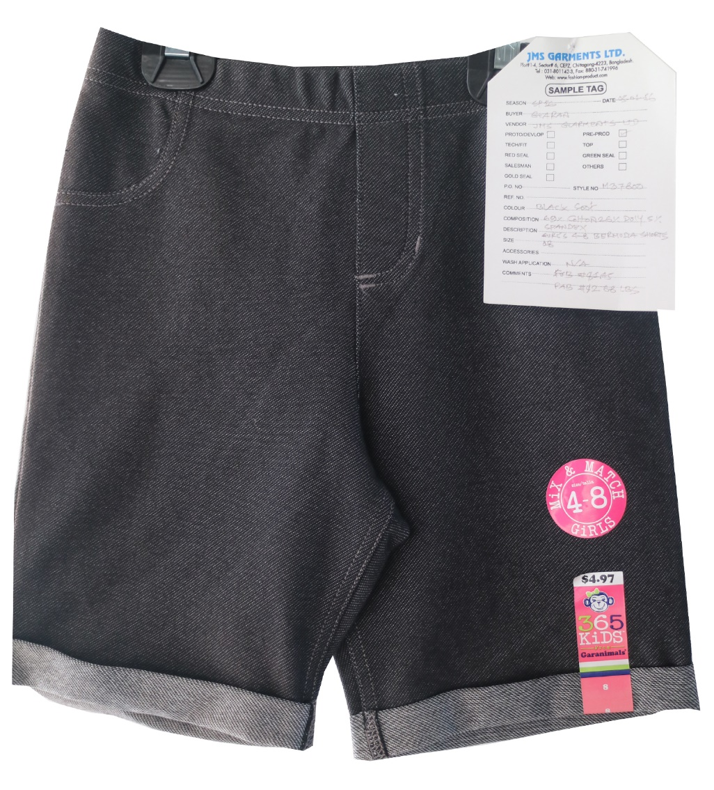
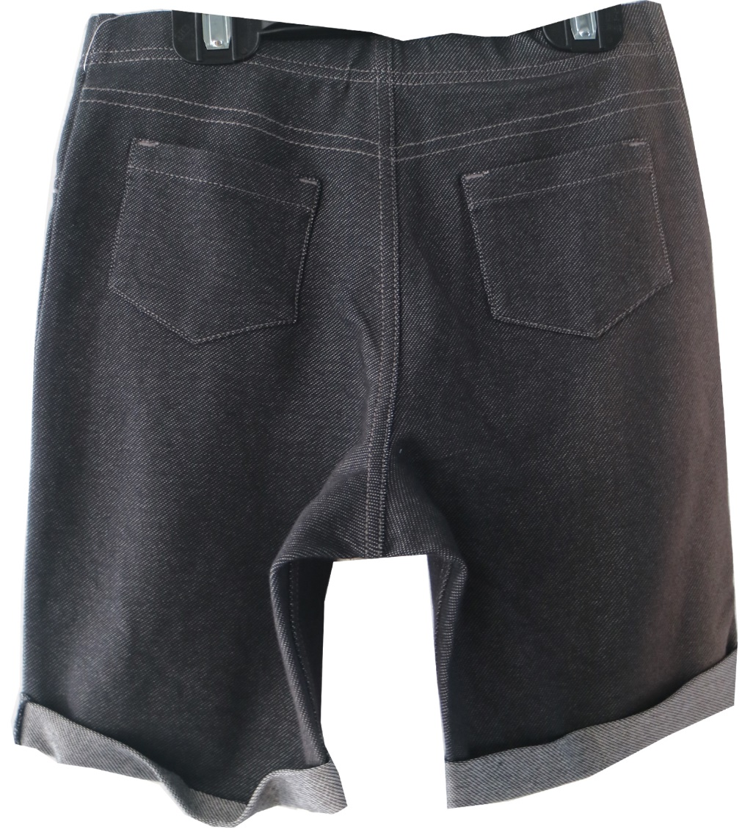
Fabrication : 69% CTTN / 27% POLY / 4% SPANDEX KNIT DENIM – 210 GSM , COLOR – BLACK SOOT

Slide 24
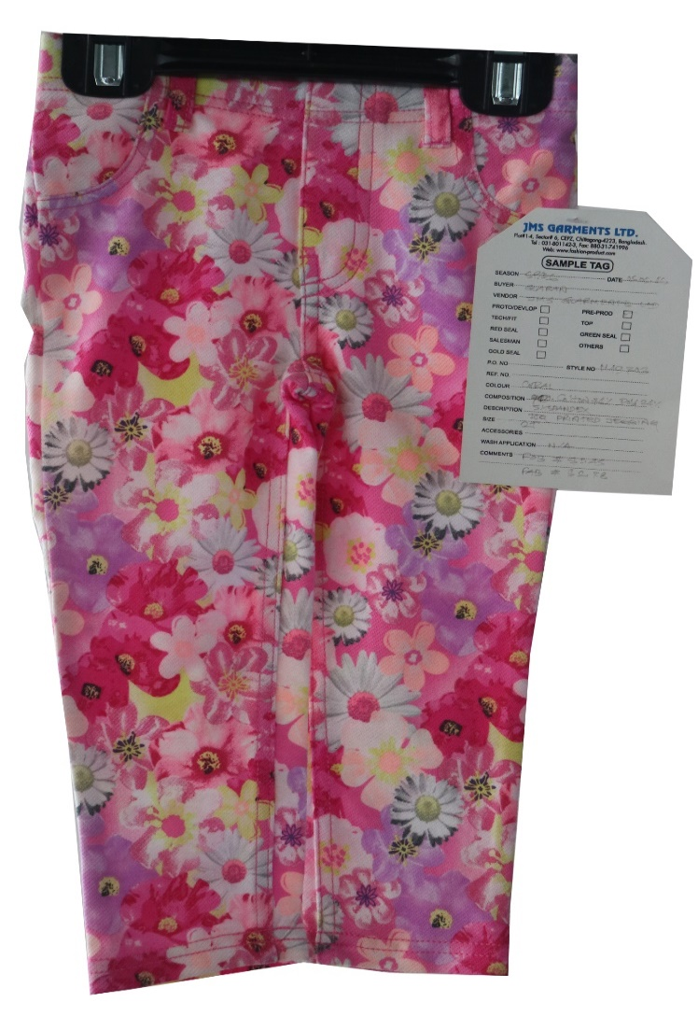
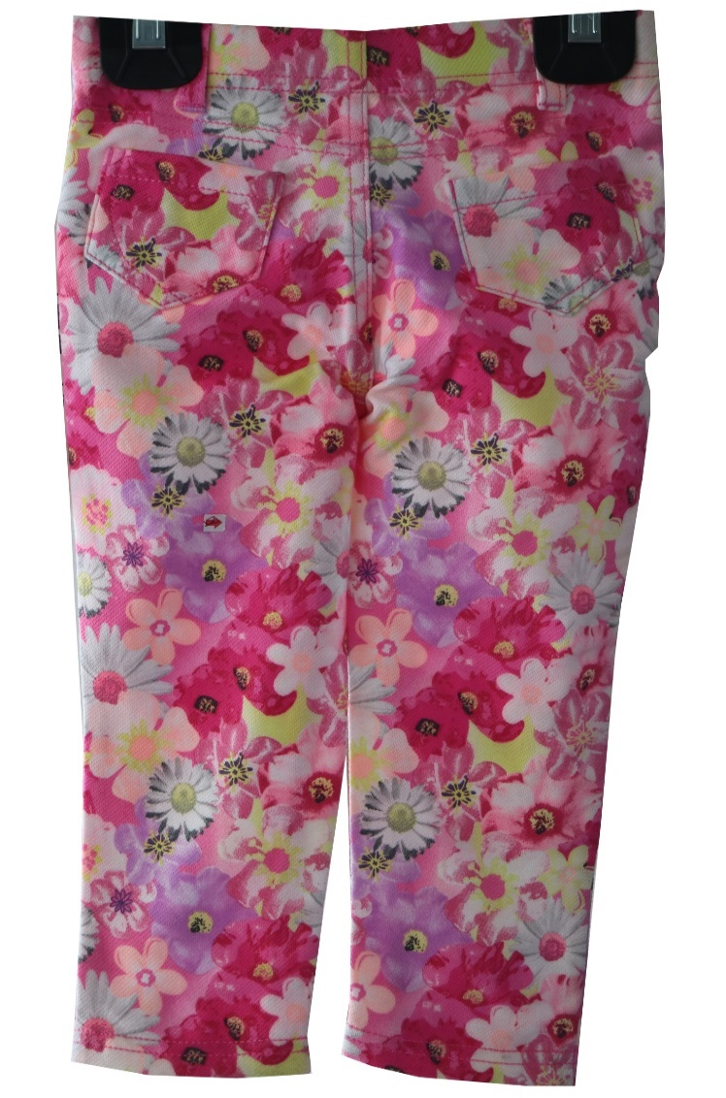
Fabrication : 71% CTTN / 25% POLY / 4% SPDX - PRINT KNIT DENIM – 210 GSM
Color : Rose Flower Print

Slide 25
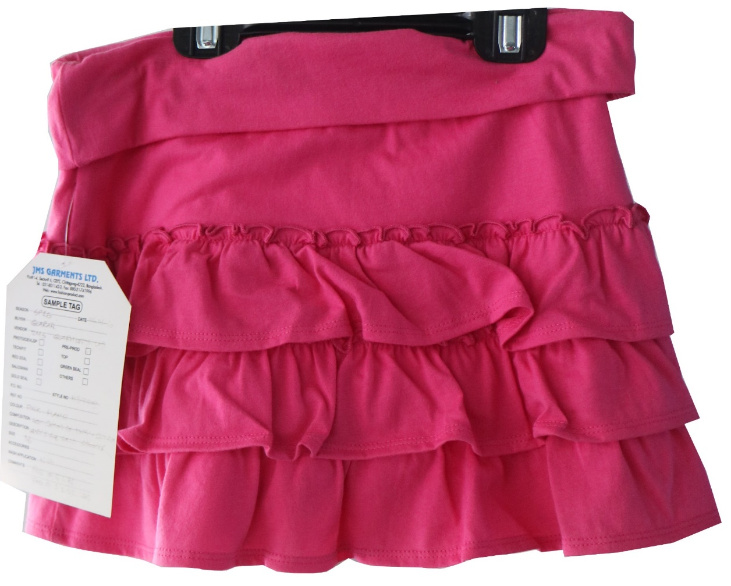
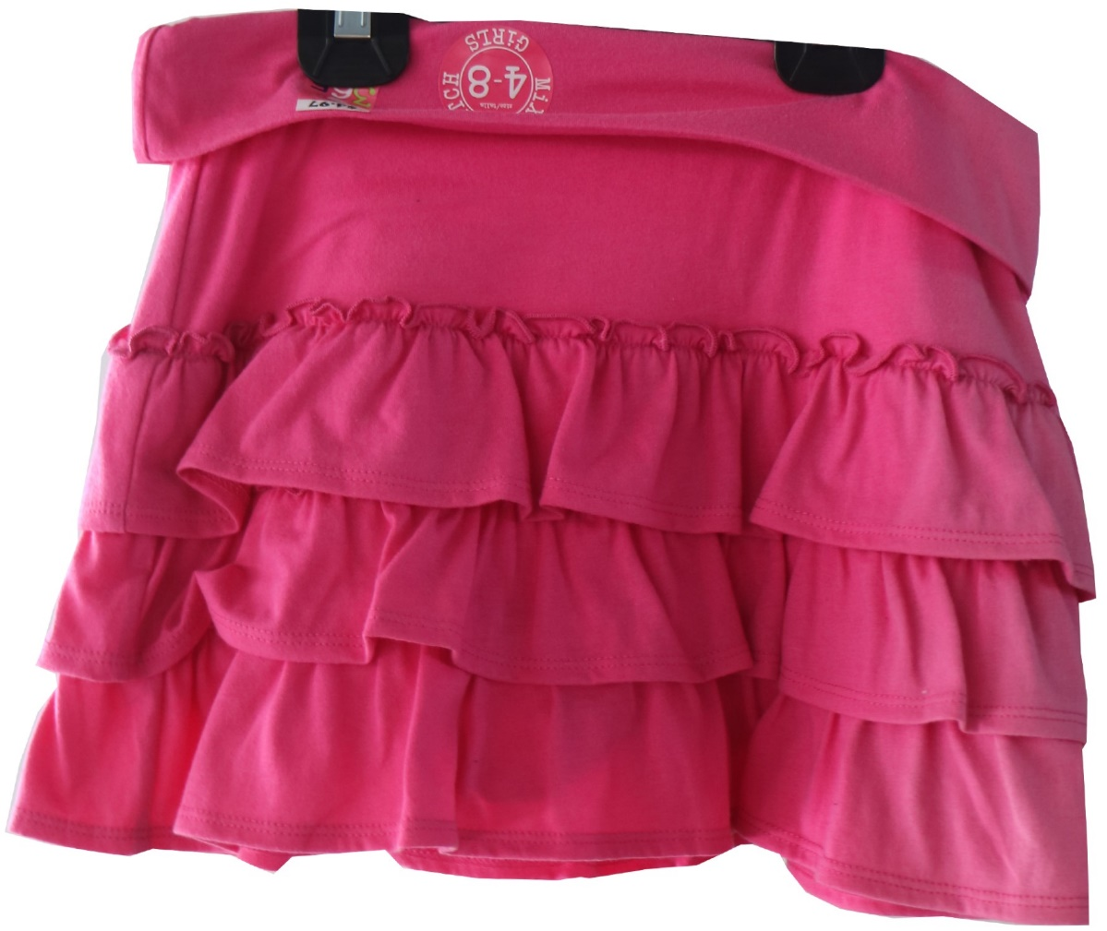
Fabrication : Body : 60% Polyester 40% Jersey -150 Gsm. Color : DK PINK

Slide 26
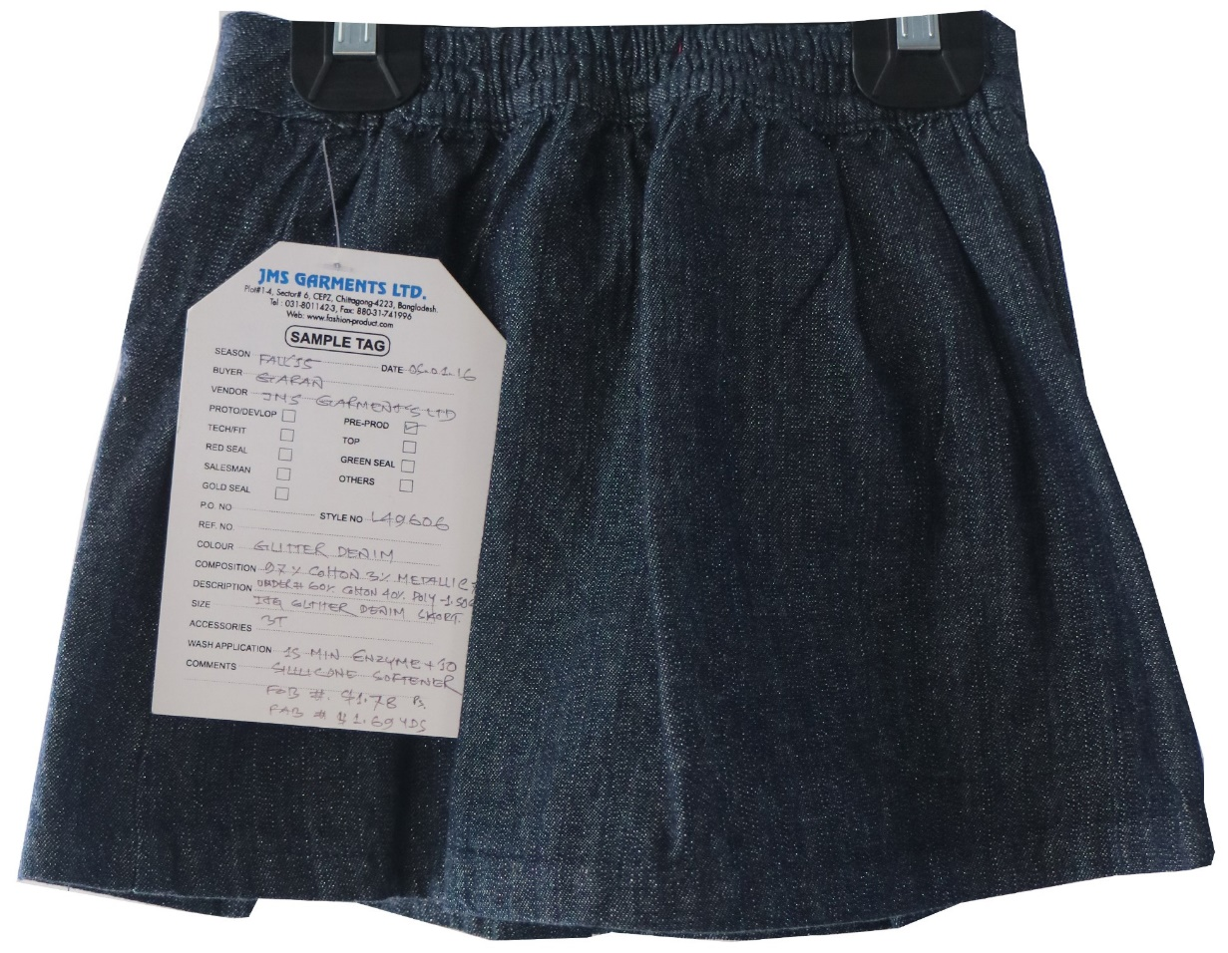
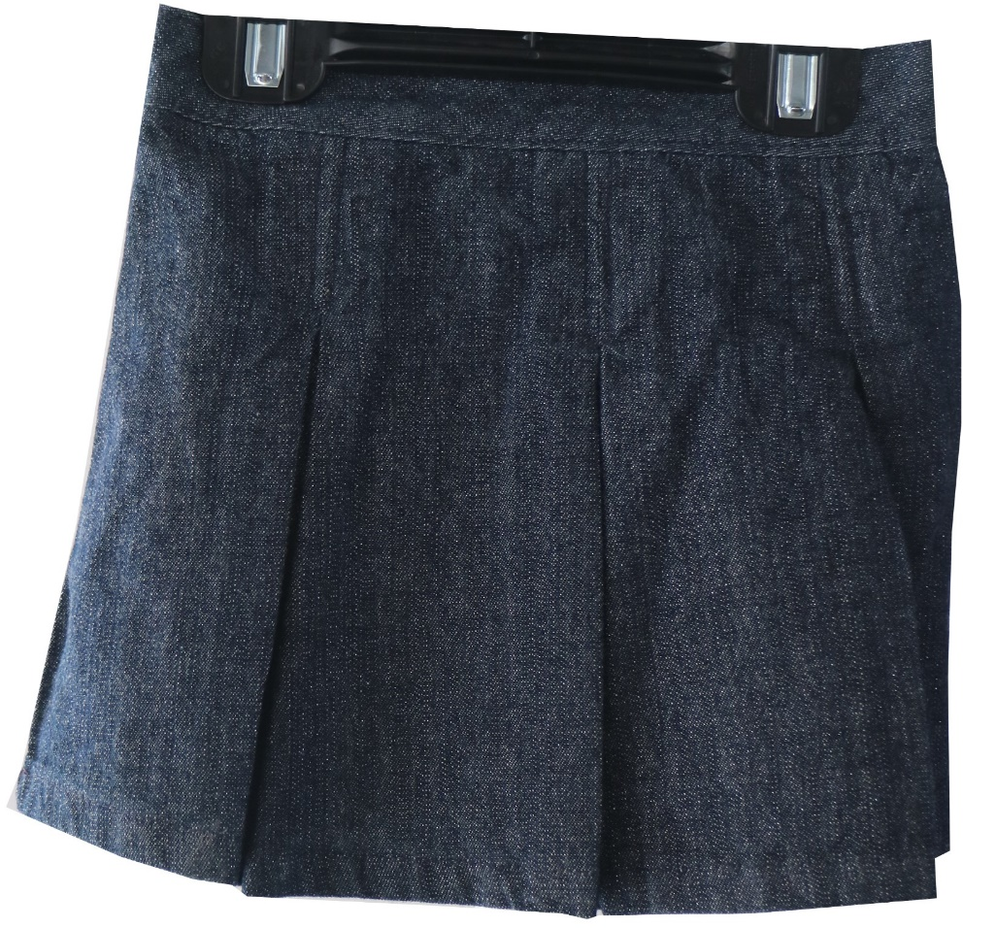
Fabrication : Body : 100% Cotton Glitter denim 7.9 oz (BEFORE WASH), ( COLOR – Indigo Denim)

Slide 27


Fabrication – 100% cotton ripstop twill - 5.6 OZ (Before Wash), Color – Baby Navy

Slide 28


Fabrication : 69% CTTN / 27% POLY / 4% SPANDEX KNIT DENIM – 210 GSM , COLOR – DK PINK

Slide 29


Fabrication : 69% CTTN / 27% POLY / 4% SPANDEX KNIT DENIM – 210 GSM , COLOR – ROSE PINK

Slide 30


Fabrication : 69% CTTN / 27% POLY / 4% SPANDEX KNIT DENIM – 210 GSM , COLOR – Black Soot

